Slide 1

CSC364-Software Engineering Week-1 Lecture-5 Semester-# Fall 2018
Prepared by:
M. Sajid Farooq

Slide 2
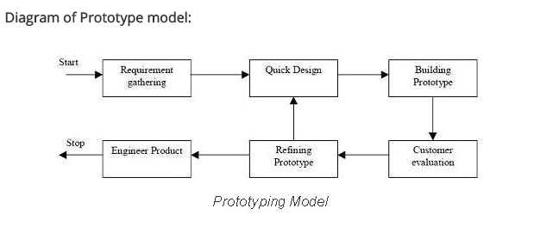
Rapid Prototyping Model

Slide 3
What is Software Prototyping?
Prototype is a working model of software with some limited functionality.
The prototype does not always hold the exact logic used in the actual software application
Prototyping is used to allow the users evaluate developer proposals and try them out before implementation.
It also helps understand the requirements which are user specific.

Slide 4
Designing a software prototype
Basic Requirement Identification
Developing the initial Prototype
Review of the Prototype
Revise and enhance the Prototype

Slide 5
Software Prototyping Pros and Cons
Pros
Increased user involvement in the product even before implementation
Since a working model of the system is displayed, the users get a better understanding of the system being developed.
Reduces time and cost as the defects can be detected much earlier.
Quicker user feedback is available leading to better solutions.
Missing functionality can be identified easily
Confusing or difficult functions can be identified
Cons
Risk of insufficient requirement analysis owing to too much dependency on prototype
Users may get confused in the prototypes and actual systems.
Practically, this methodology may increase the complexity of the system as scope of the system may expand beyond original plans.
Developers may try to reuse the existing prototypes to build the actual system, even when its not technically feasible
The effort invested in building prototypes may be too much if not monitored properly

Slide 6
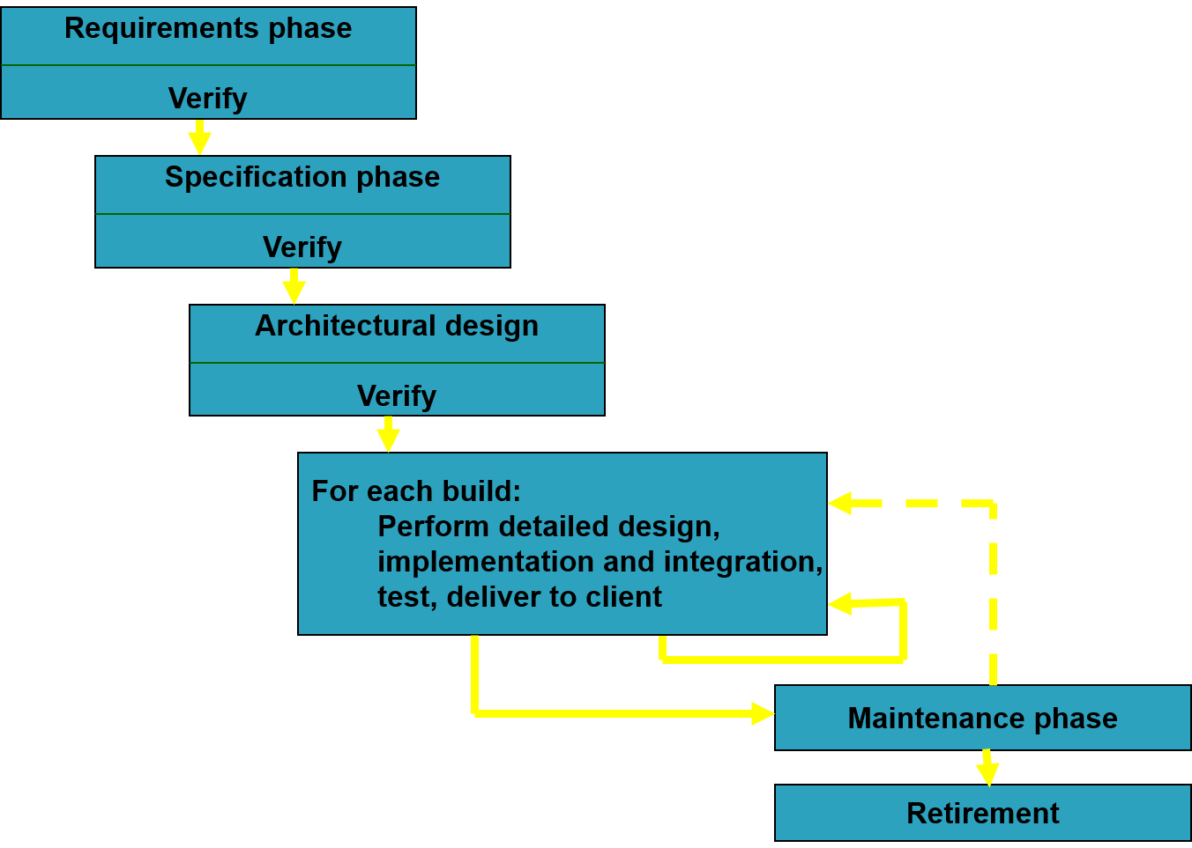
Incremental Model

Slide 7
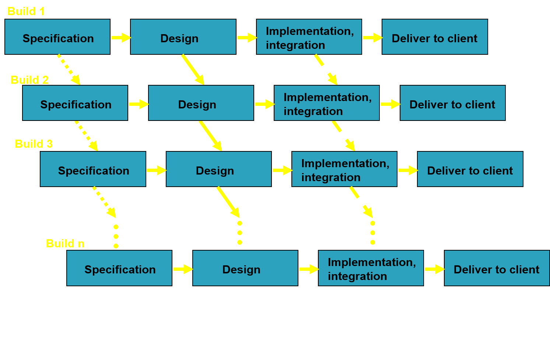
Incremental Model (cont.)

Slide 8
Incremental Model (cont.)
In incremental model the whole requirement is divided into various builds.
Multiple development cycles take place here, making the life cycle a “multi-waterfall” cycle” .
Cycles are divided up into smaller, more easily managed modules.

Slide 9
Incremental Model (cont.)
Each module passes through the requirements, design, implementation and testing phases.
A working version of software is produced during the first module, so you have working software early on during the software life cycle
Each subsequent release of the module adds function to the previous release.
The process continues till the complete system is achieved

Slide 10
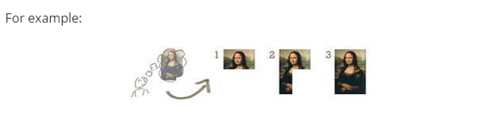
Incremental Model (cont.)

Slide 11
Advantages of Incremental model
Generates working software quickly and early during the software life cycle.
This model is more flexible – less costly to change scope and requirements.
It is easier to test and debug during a smaller iteration.
In this model customer can respond to each built.

Slide 12
Disadvantages of Incremental model:
Needs good planning and design.
Needs a clear and complete definition of the whole system before it can be broken down and built incrementally.
Total cost is higher than waterfall.

Slide 13
When to use the Incremental model
This model can be used when the requirements of the complete system are clearly defined and understood.
Major requirements must be defined; however, some details can evolve with time.
There is a need to get a product to the market early.
A new technology is being used

Slide 14
The End

Slide 15
Q & A

Slide 16
References
These lecture notes were taken from following source:

